Slide 1
Stewart McNaughton Health and Safety Consultant – HAVS
Reactec Ltd

Slide 2
Hand Arm Vibration Syndrome What’s the problem?
HAVS sufferers face long term disablement.
There is no cure.
Prevention is the only option.

Slide 3
Hand Arm Vibration Syndrome What’s the problem?
5 million power tool users in Great Britain*
2 million exposed to high levels*
50% of all reported Occupational industrial diseases are HAVS related*
300,000 suffering advanced stages**
* HSE **Medical Research Council

Slide 4
Hand Arm Vibration Syndrome
What’s the problem?
Disturbance to hand function caused
by transmitted vibration
Blood Vessels
Nervous System
Muscoskeletal Damage
Symptoms include tingling, numbness, reduced grip
or dexterity and pain, often severe.

Slide 5
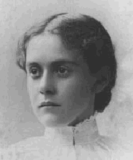
Hand Arm Vibration Syndrome
History
1911: Symptoms first described by Professor Giovanni Loriga in Italy
1918: Dr Alice Hamilton MD refers to
“dead fingers" syndrome in 1918
1970: Dr Alice Hamilton dies, aged 101
1970: Term ‘vibration induced white finger’ coined by Industrial Injury Advisory Council

Slide 6
Hand Arm Vibration Syndrome
History
Dr Hamilton:
“The trouble seems to be caused by the vibrations of the tool, and cold.
If these features can be eliminated the trouble can be decidedly lessened.“

Slide 7
Hand Arm Vibration Syndrome
History
1975: First scale published for assessing the condition - The Taylor-Pelmear scale
1985: Listed as a prescribed disease in UK
1997: UK High Court awarded £127,000
in compensation to seven coal miners
for vibration white finger
2004: UK government fund set up to
cover subsequent claims by
ex-coalminers exceeds £100 million
in payments.

Slide 8
HAVS Current Legislation
Interpretation
Health And Safety At Work Act 1974.
Provision and Use of Work Equipment Regulations 1998.
Management Of Health And Safety At Work Regulations 1999.
Physical Agents (Vibration) Directive 2002.
Control of Vibrations Regulations 2005.
Supply of Machinery (Safety) Regulations 2008.

Slide 9
HAVS Current Legislation
Exemptions
Emergency services
Air transport
Ministry of Defence

Slide 10
The Control of Vibrations Regulations 2005
Protect workers from harmful effects
of vibration exposure transmitted by hand contact

Slide 11
Risk Assessment
Suitable health surveillance should be undertaken where risk assessment indicates a risk to workers’ health.

Slide 12
Why and how to detect/report symptoms of HAVS
Most surveillance is carried out annually
Susceptible individuals can develop symptoms in 6 months or less

Slide 13
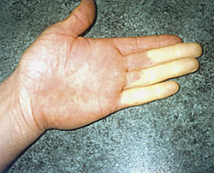
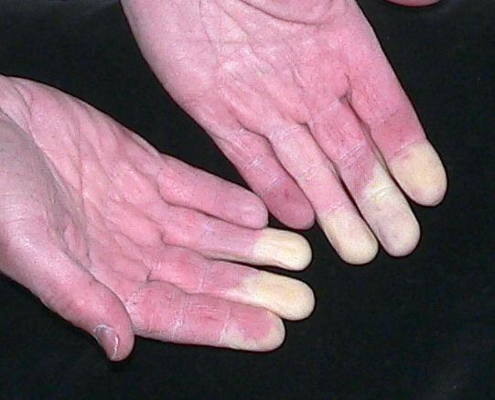
Employee

Slide 14
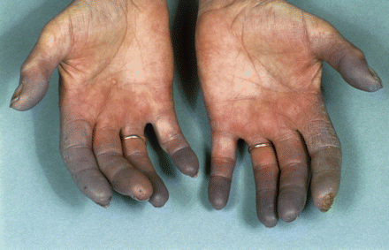
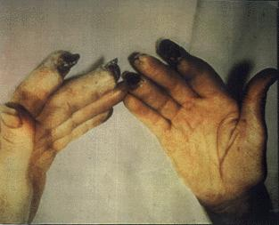
Employee

Slide 15
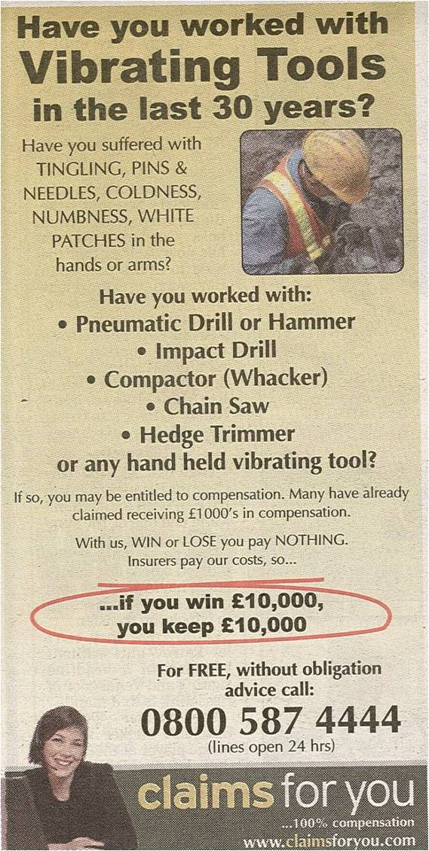
AMBULANCE CHASING?
It is reasonable to expect that this emerging market will be filled by qualified professionals.

Slide 16
Hand Arm Vibration Syndrome
Litigation
Hand Arm Vibration Claim: Solicitor Sets Out Compensation Amounts For HAVS, Vibration White Finger, Reynaud's Syndrome, Whole Body Vibration Syndrome
1. Financial losses and expenses
2. Pain and Suffering
3. Legal Costs
Hand arm vibration affecting the fingers: £2,000 - £11,000
2. Disability to one or both hands: £11,000 - £25,000
'Substantial' payout to Cumbrian man whose hands damaged at work
By Jenny Barwise
Thompsons Solicitors
£30,000 payout for young man from Doncaster who had to change jobs after vibrating tools permanently damaged his hands

Slide 17
Hand Arm Vibration Syndrome
Litigation
Hand ArmVibration Compensation Claim Amounts
Hand arm vibration syndrome is classed as an industrial injury and as such it is possible to make a claim for personal injury compensation if employer blame has been established for the injuries sustained.
See below compensation examples;
£15,000 compensation for a construction worker that used hydraulic breakers and wacker plates and developed vibration white finger.
£10,000 injury compensation for a construction worker using pneumatic tools such as vibrating pokers, scrablers, whacker plates and kango hammers over a 20 year period who developed hand arm vibration syndrome
£6,761 awarded to an employee of the National Coal Board that had hand arm vibration syndrome.
£4,000 out of court settlement to an engineering worker that used needle guns and grinders and developed vibration white finger. £10,000 compensation awarded to a steel fabricator after he developed vibration white finger.
£20,000 injury compensation to a steel fabricator that used angle grinders on a daily basis after he developed a hand arm vibration syndrome condition.

Slide 18
Hand Arm Vibration Syndrome
Litigation
Unite member David Hopps, 65 has received a £15,000 out of court payout after developing Hand Arm Vibration Syndrome (HAVS), caused by the maintenance craftsman’s use of vibrating tools at Drax Power Station.
Worker receives payout over hand injury
A STOURBRIDGE man has received a £10,000 out of court payout after his hands were left permanently damaged by using vibrating tools at work.
Keith Rowley, aged 55, was left with the debilitating condition Hand Arm Vibration Syndrome (HAVS), also known as Vibration White Finger, after using vibrating tools in his job as a fitter.
His employer General Kinematics Ltd based in Kingswinford did not admit liability - but settled the claim out of court after Keith’s union, the GMB (Britain’s General Union), instructed Thompsons Solicitors to pursue compensation for his injury

Slide 19
Vibration exposure risk assessment
Your risk assessment should:
Identify where there might be a risk from vibration and who is likely to be affected
Contain a reasonable estimate of your employees’ exposures
Identify what you need to do to comply with the law eg whether vibration control measures are needed, and, if so, where and what type
Identify any employees who need to be provided with health surveillance and whether any are at particular risk

Slide 20
Health Surveillance
Is identifying HAVS sufferers merely doing the minimum?
Most surveillance is carried out annually
Susceptible individuals can develop symptoms in 6 months or less
Isn’t prevention better than identification?

Slide 21
The Value of Continuous Monitoring
Efficient and timely analysis of data
Swift Identification of over exposure
Early Intervention and Prevention
Involves Workforce
Contributes to Workforce Safety Awareness
Aids change Management

Slide 22
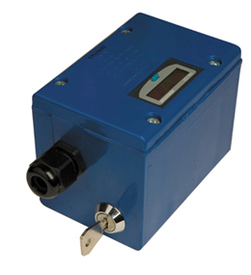
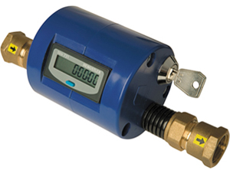
HAVS Management Tools
Tooltimer

Slide 23
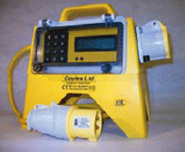
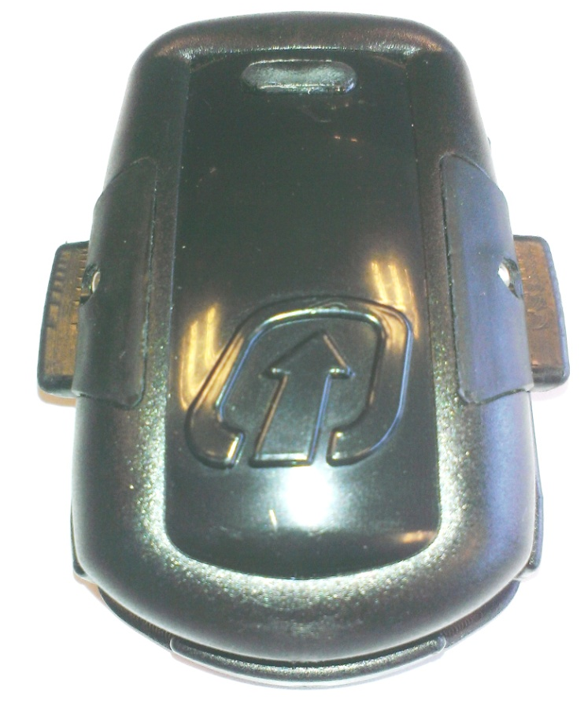
HAVS Management Tools
HAVsafe
Curo

Slide 24
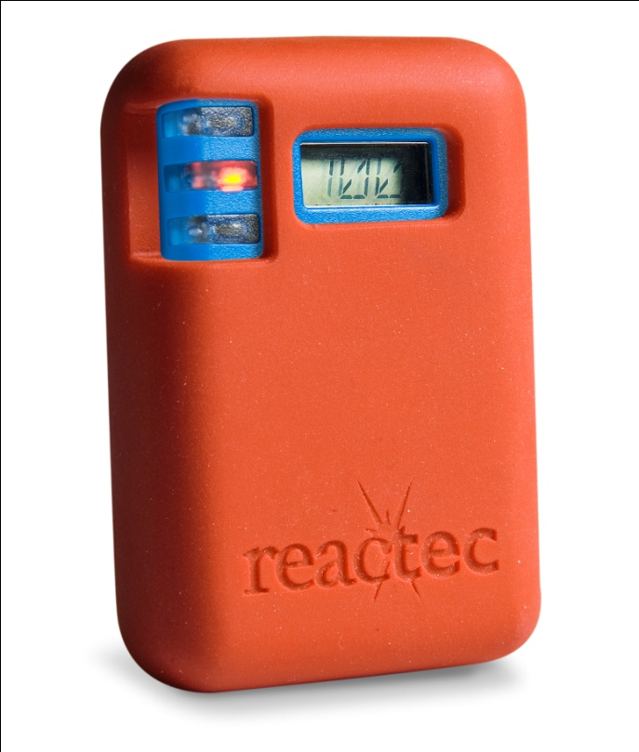
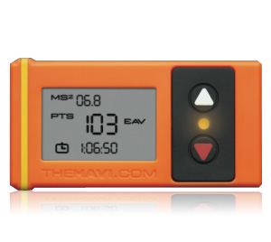
HAVS Management Tools
HAVmeter
HAVi

Slide 25
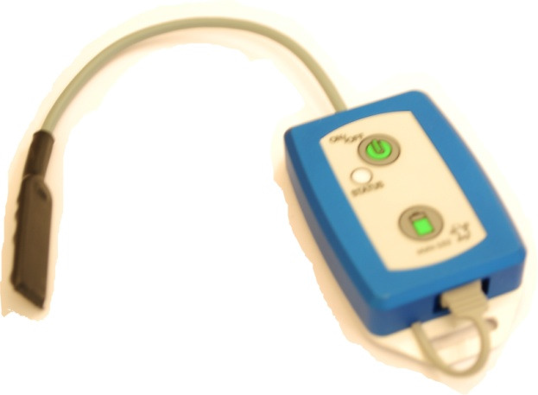
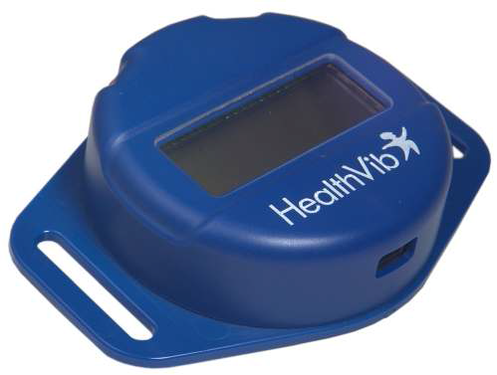
HAVS Management Tools
HealthVib® HAV

Slide 26
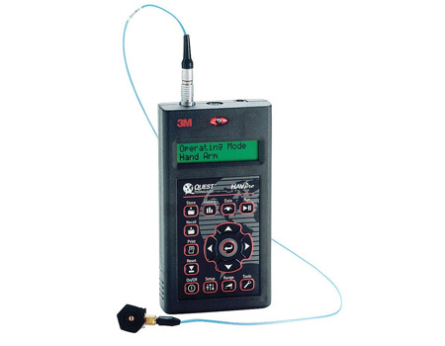
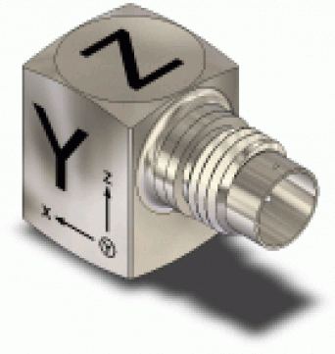
HAVS Management Tools
HAV- pro

Slide 27
HAVS Management Tools
......and paper

Slide 28
Benefits of HAVS Management

Slide 29
Benefits of HAVS Management
Reduced Labour Costs
Accurate HAV data
Accurate Trigger Time Data
Timely & salient reporting
Increased Productivity
Supports Tool Management

Slide 30
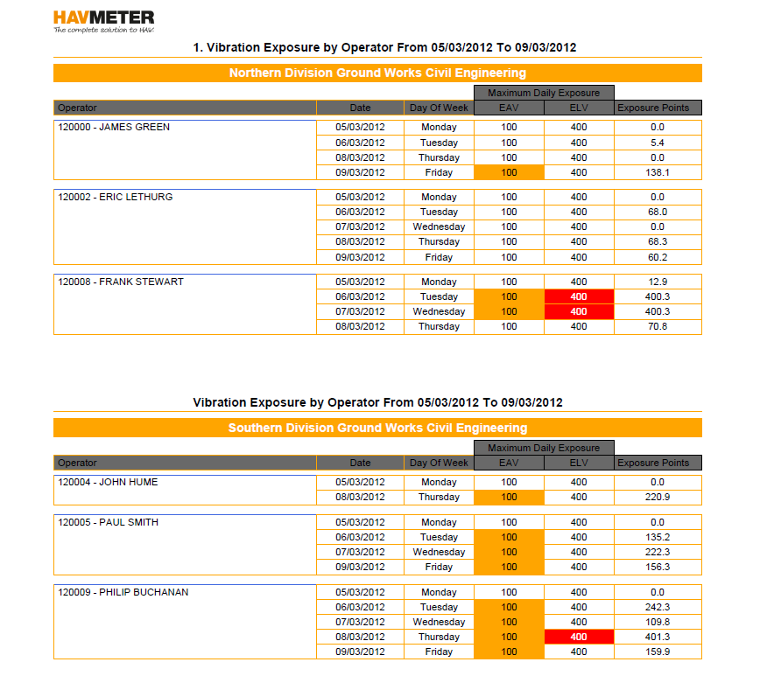
Reporting
Simple overview of operative exposure
Instances where EAV/ ELV are exceeded highlighted automatically
Records kept indefinitely
Information defendable in court
Quick & easy to produce

Slide 31
Reporting
Quantifies exposure
Quantifies risk
Identifies high risk employees, tools and activities
Raises awareness
Educates
Enables prevention before detection

Slide 32
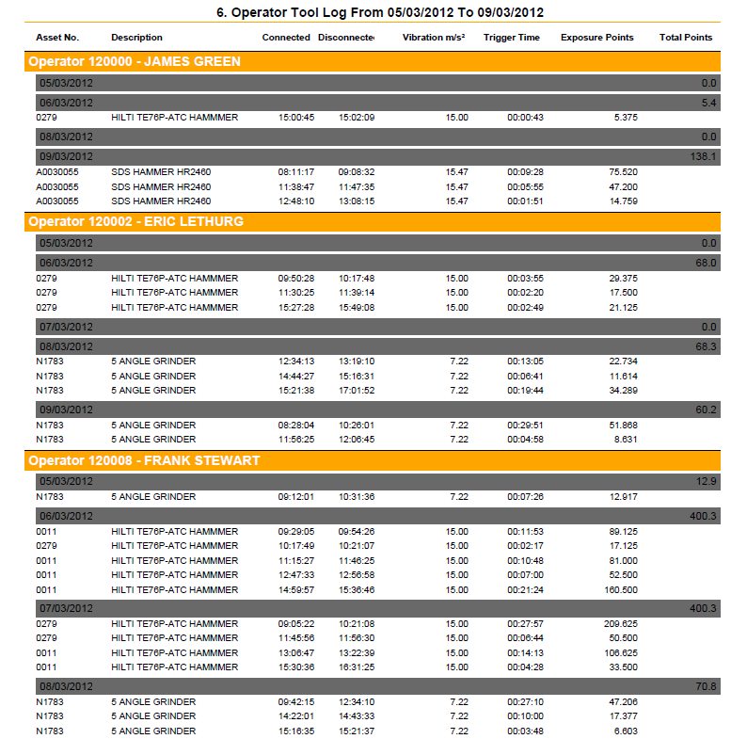
Reporting
Detailed information of what tools are being used and when
Easily investigate which tools causing over exposure
Staff productivity analysis
Potential for comparison of task completion rates between squads

Slide 33
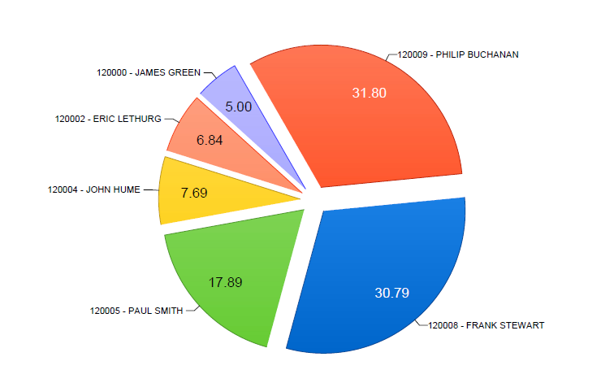
Reporting
Easy to read pie chart showing individuals share of exposure as percentage of the team
Useful ongoing management tool
Allows supervisors to balance out total exposure among team

Slide 34
Best practice
Organisations Supporting continuous monitoring

Slide 35
End
Thank you

